Slide 1

PIZZA STORE SALES ANALYSIS SQL
SQL Based project

Slide 2

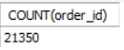
Q1 > Total number of orders placed
SYNTAX:
SELECT COUNT(order_id)FROM orders;
ANSWER:

Slide 3
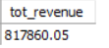
Q2 > Total Revenue generated from store
SYNTAX:
select round(sum(a.quantity*b.price),2) as tot_revenue from order_details as a join pizzas as b on a.pizza_id = b.pizza_id;
ANSWER:

Slide 4

Q3> Highest priced pizza
SYNTAX:
SELECT a.name, b.price FROM pizza_types AS a JOIN pizzas AS b ON a.pizza_type_id = b.pizza_type_id
ORDER BY b.price DESC
LIMIT 1;
ANSWER:

Slide 5
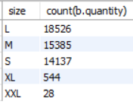
Q4> Most common pizza size ordered
SYNTAX:
select a.size, count(b.quantity) from pizzas as ajoin order_details as b on a.pizza_id = b.pizza_idgroup by 1order by count(b.quantity) desc;
ANSWER:

Slide 6
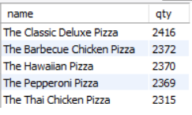
Q5> LIST 5 MOST ORDERED PIZZA TYPES WITH QTY
SYNTAX:
select a.name, count(b.quantity) as qty from pizza_types as a join pizzas as c on a.pizza_type_id = c.pizza_type_idjoin order_details as b on c.pizza_id = b.pizza_idgroup by 1order by 2 desclimit 5;
ANSWER:

Slide 7
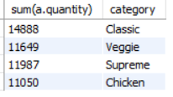
Q6> FIND TOTAL QTY OF EACH PIZZA CATEGORY ORDERED
SYNTAX:
Select sum(a.quantity), b.category from order_details as ajoin pizzas as c on a.pizza_id = c.pizza_idjoin pizza_types as b on c.pizza_type_id = b.pizza_type_idgroup by 2;
ANSWER:

Slide 8
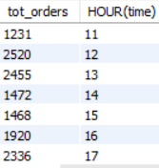
Q7> DISTRIBUTION OF ORDERS BY HOUR OF THE DAY
SYNTAX:
SELECT count(order_id) as tot_orders , HOUR(time) FROM ordersgroup by HOUR(time);
ANSWER:

Slide 9
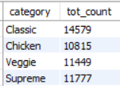
Q8> CATEGORY-WISE DISTRIBUTION OF PIZZAS
SYNTAX:
SELECT a.category, count(b.order_id) as tot_count FROM pizza_types as aJOIN pizzas as con a.pizza_type_id = c.pizza_type_idJOIN order_details as don c.pizza_id = d.pizza_idjoin orders as b on d.order_id = b.order_idGROUP BY 1;
ANSWER:

Slide 10
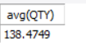
Q9> CALCULATE AVG NUMBERS OF PIZZA ORDERED PER DAY
SYNTAX:
WITH AA AS (SELECT A.date, sum(B.quantity) AS QTY FROM orders AS AJOIN order_details AS B ON A.order_id = B.order_idgroup by 1)select avg(QTY) from AA;
ANSWER:

Slide 11
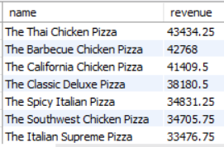
Q10> FIND MOST ORDERED PIZZA NAME BASED ON REVENUE
SYNTAX:
select a.name, round(sum(c.quantity*b.price),2) as revenue from pizza_types as a join pizzas as bON a.pizza_type_id = b.pizza_type_idjoin order_details as con b.pizza_id = c.pizza_idgroup by 1order by 2 desc;
ANSWER:

Slide 12
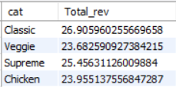
Q11> PERCENTAGE CONTRIBUTION OF EACH PIZZA CATEGORY TO TOTAL REVENUE
SYNTAX:
with aa as ( select a.category as cat, round(sum(b.price*c.quantity),2) as Trevenue from pizza_types as a Join pizzas as b on a.pizza_type_id = b.pizza_type_id join order_details as c on b.pizza_id = c.pizza_id group by 1)select cat, (Trevenue/(select sum(Trevenue) from AA))*100.0 as Total_rev from aa;
ANSWER:

Slide 13
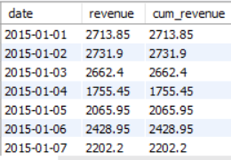
Q12> ANALYZE CUMMULATIVE REVENUE GENERATED
SYNTAX:
with aa as ( SELECT a.date as date, round(sum(b.price*d.quantity),2) AS revenue from orders as a join order_details as d on a.order_id = d.order_id join pizzas as b on b.pizza_id = d.pizza_id group by 1)select date, revenue, sum(revenue) over (partition by date order by date) as cum_revenue from aa;
ANSWER:

Slide 14
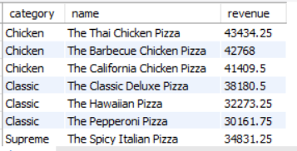
Q13> Top 3 most ordered pizza name based on revenue, for each pizza category
SYNTAX:
with BB as (with AA as( select a.category, a.name, round(sum(b.price*c.quantity),2) as revenue from pizza_types as a join pizzas as b on a.pizza_type_id = b.pizza_type_id join order_details as c on c.pizza_id = b.pizza_id group by 1,2)select category, name, revenue, row_number()over(partition by category order by revenue desc) as rankk from AA)select category, name, revenue from BBwhere rankk<=3;
ANSWER:

